Slide 1


01
VISUAL ANALYTICS PROJECT
Owens - Radhika - Prakhar - Aayush

Slide 2

02
PROJECT INTRODUCTION
Our project is about a quiz implementation using React.Js App. We created a single-page application (SPA) for our quiz and defined different questions page, as well as a home page, a results page, and an about page. For the main libraries in our project, we utilised FetchAPI to fetch our data from a local JSON file, ReactContext for defining global variables, useState for changing state
values inside a function component, and bootstrap for extra customization for our design. Moreover, we also added react-countUp in our Home Page and react-confetti in our Results Page.
Visual Analytics Project - Quiz

Slide 3
03
PROJECT MEMBERS
Radhika Barve - BS20DMU008
Implemented effects, css properties, react-router-dom
Implemented recharts, confetti, and linear gradients
Designed template, questions and configured the SPA
Prakhar Mishra - BS20DMU019
Setup JSON, and FetchAPI
Implemented Bootstrap, react-router-dom
Implemented effects and css templates
Designed template, questions and configured the SPA
Gavriel Owens - BF21DSY004
Setup JSON, and FetchAPI,
Implemented dynamic filters (global variables), and React CountUp
Implemented css templates,
Designed template, questions and configured the SPA
Visual Analytics Project - Quiz

Slide 4
04
PROJECT
PREVIEW
Screenshots of the quiz implementation.
Visual Analytics Project - Quiz

Slide 5
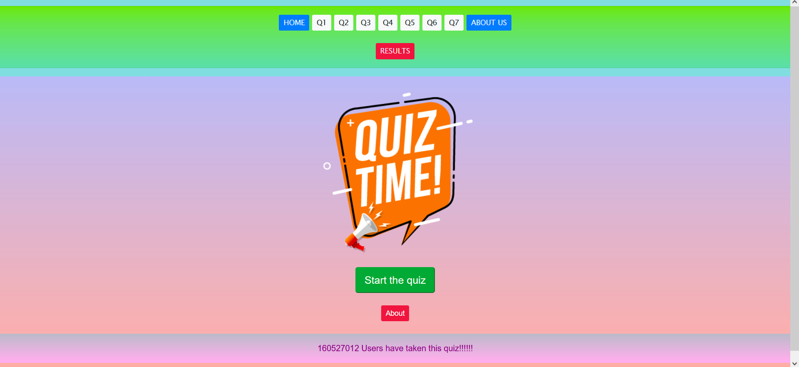
05
Home Page and Header Page
Visual Analytics Project - Quiz

Slide 6
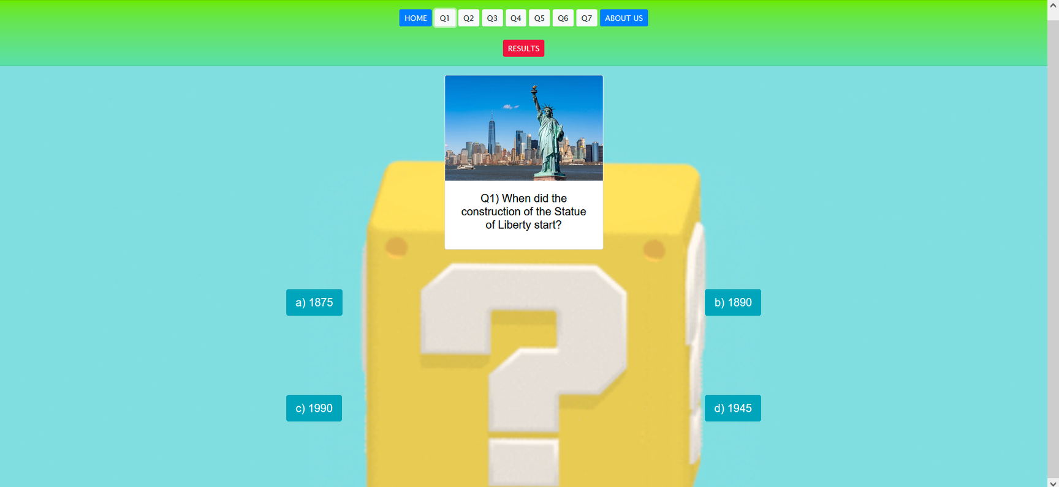
06
Question #1 Page
Visual Analytics Project - Quiz

Slide 7
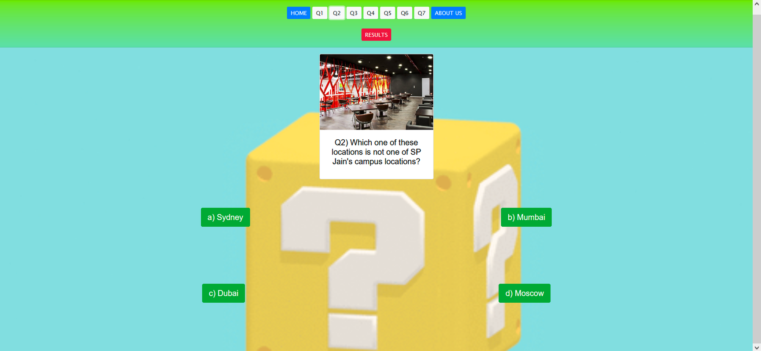
07
Question #2 Page
Visual Analytics Project - Quiz

Slide 8
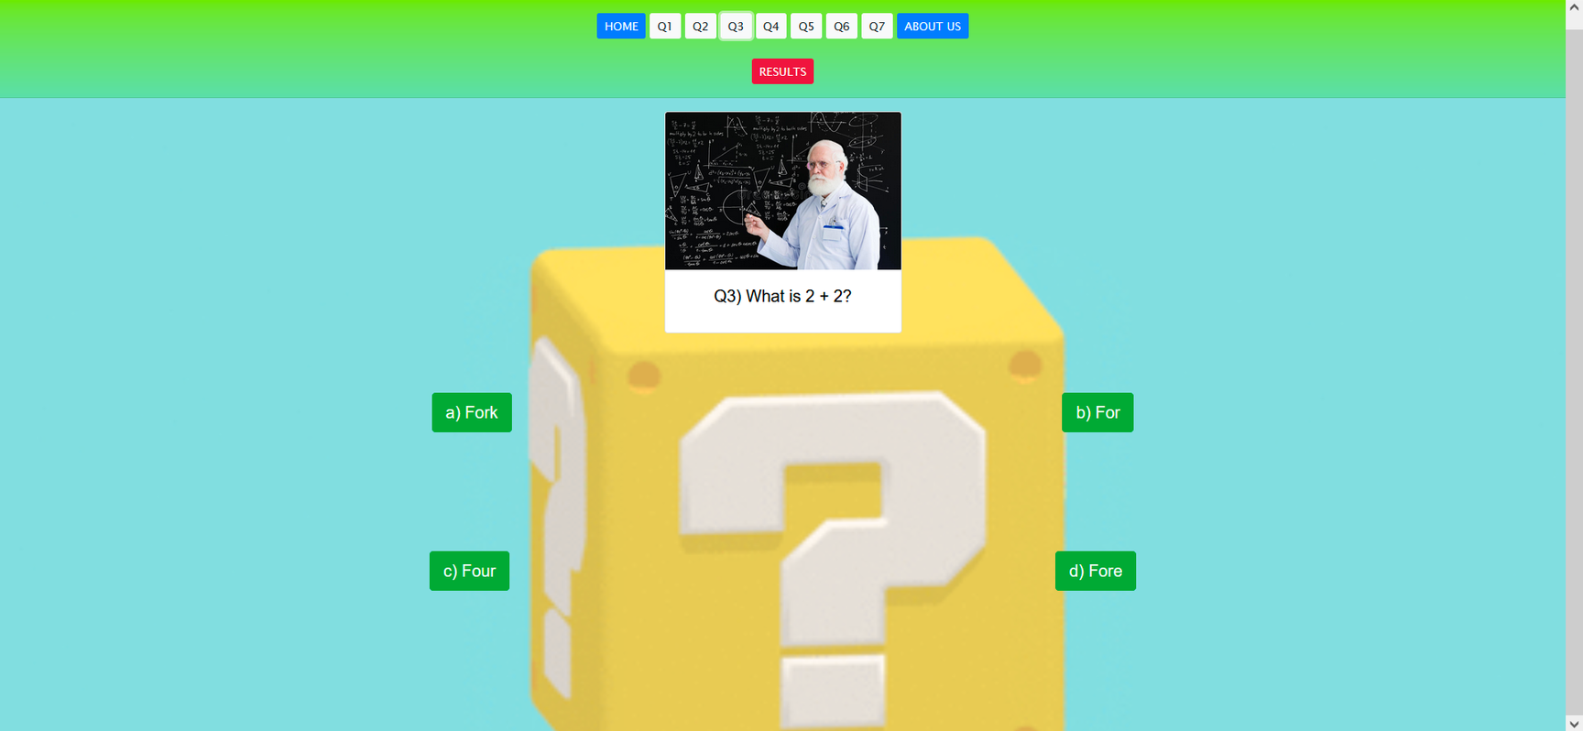
08
Question #3 Page
Visual Analytics Project - Quiz

Slide 9
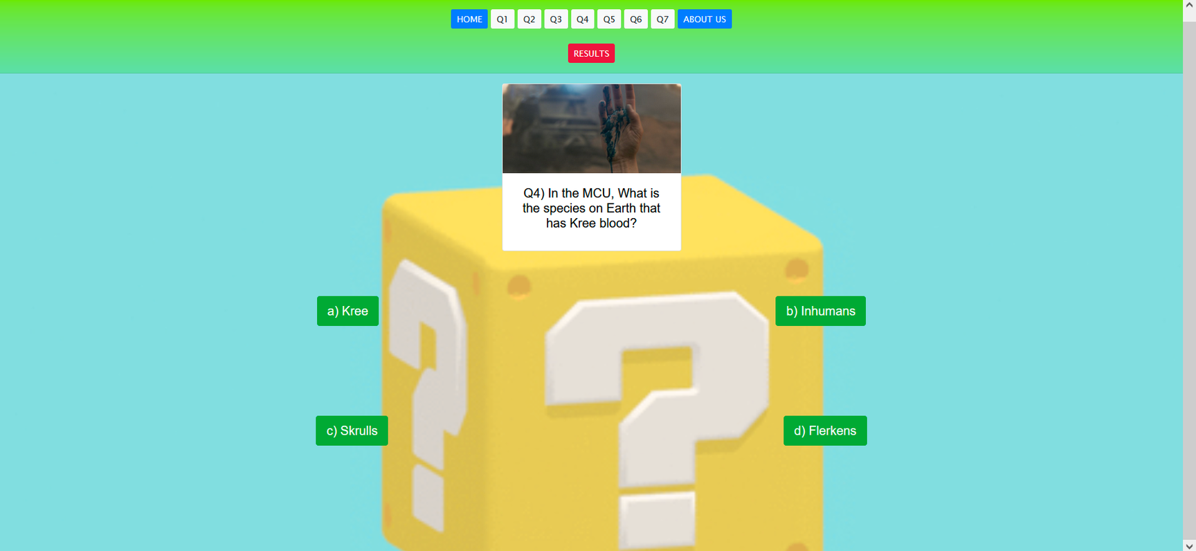
09
Question #4 Page
Visual Analytics Project - Quiz

Slide 10
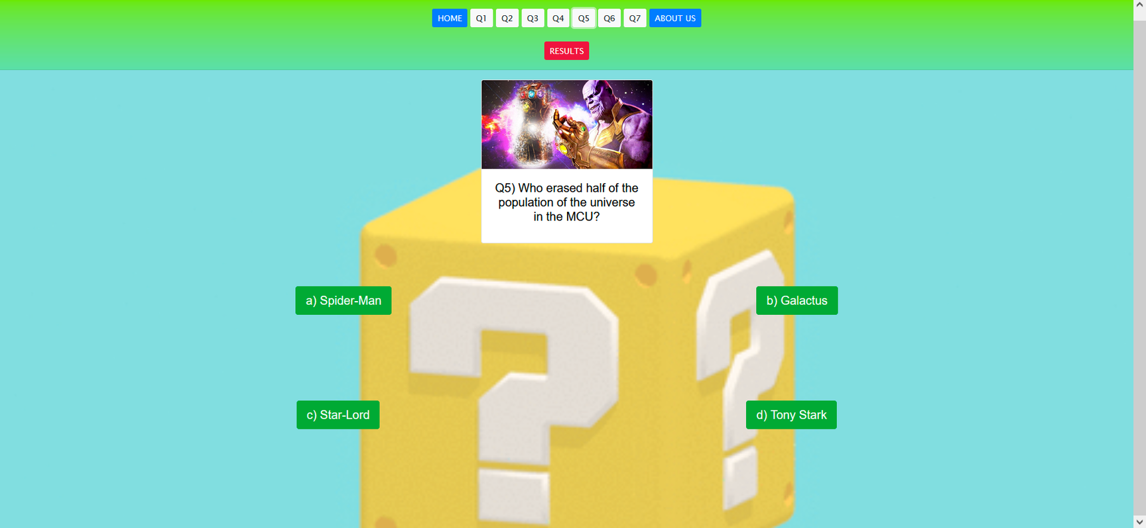
10
Question #5 Page
Visual Analytics Project - Quiz

Slide 11
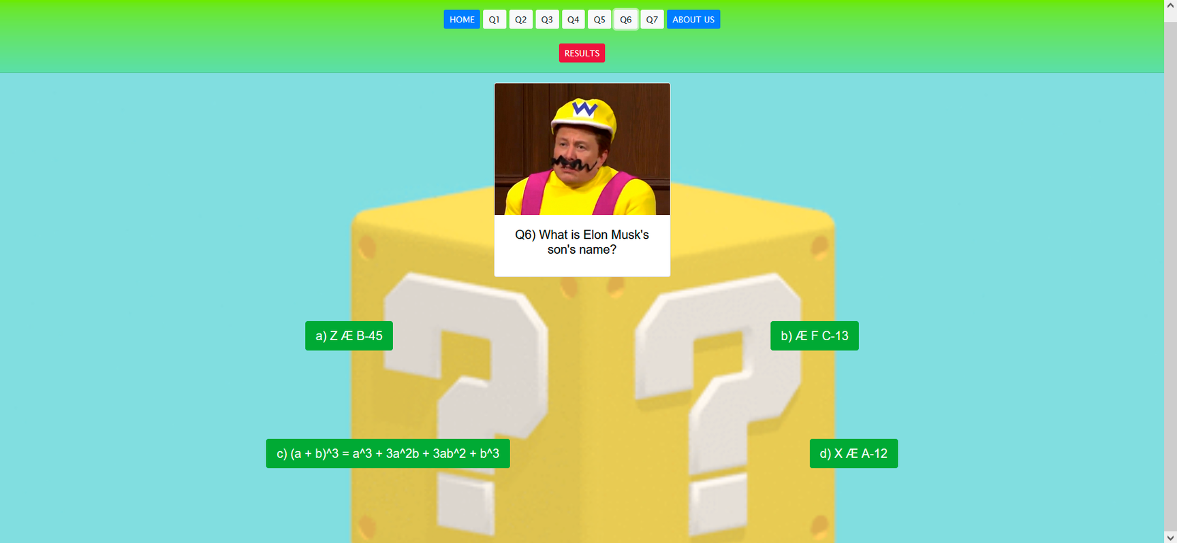
11
Question #6 Page
Visual Analytics Project - Quiz

Slide 12
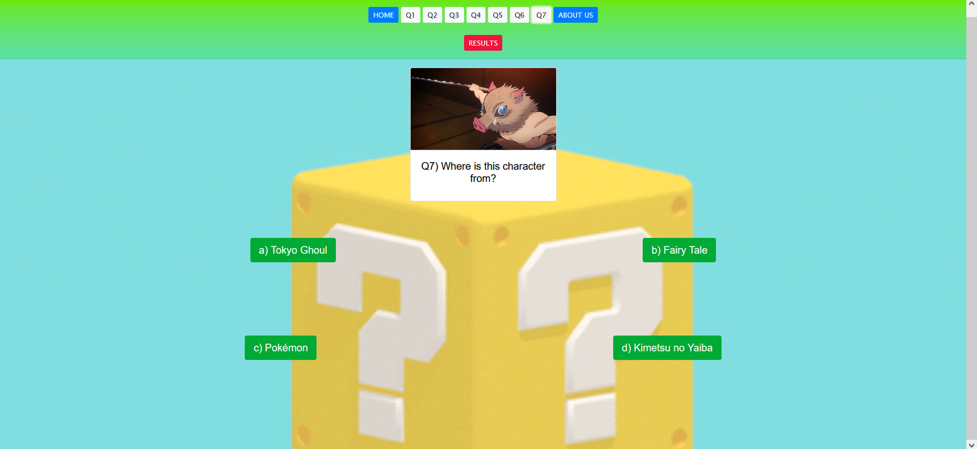
12
Question #7 Page
Visual Analytics Project - Quiz

Slide 13
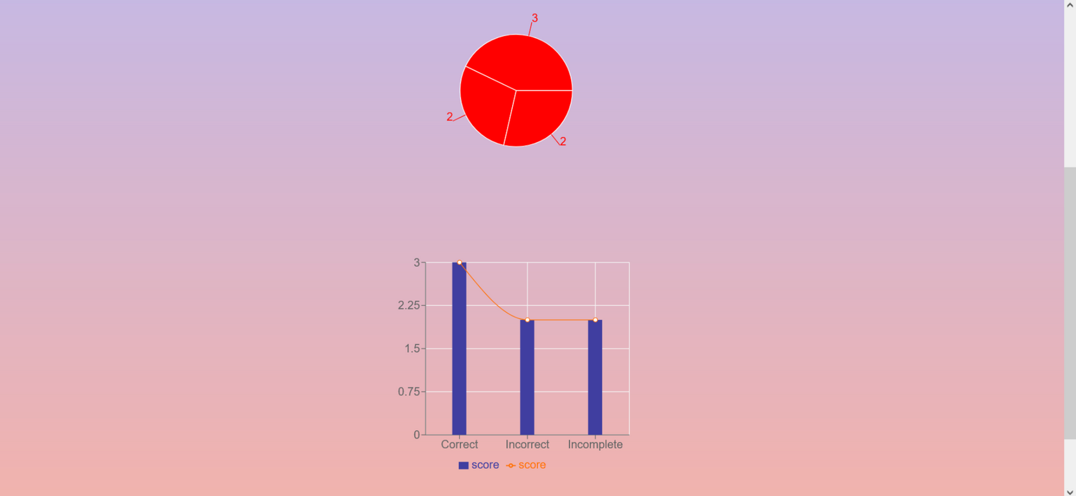
13
Results Page
Visual Analytics Project - Quiz

Slide 14
14
About Page
Visual Analytics Project - Quiz

Slide 15

15
THANK YOU FOR LISTENING.
Have a nice day!
Visual Analytics Project - Quiz

